Slide 1


Elastic pp Scattering at RHIC
Mainly :
Elastic pp scattering program at RHIC
Data analysis for the 2009 run
Results (A_{N}, r₅, A_{NN} & A_{SS})
Kin Yip
For STAR Collaboration
Brookhaven National Lab.
STAR
Sept. 7, 2011, Alushta, Crimea, Ukraine

Slide 2
RHIC-Spin Accelerator Complex
RHIC pC “CNI” polarimeters
absolute pH
polarimeter
Former location of pp2pp
RHIC
Siberian Snakes
Siberian
Snakes
PHENIX
STAR
Spin Rotators
β* ~ 21 m for pp2pp/STAR in 2009
LINAC
BOOSTER
5% Snake
Pol. Proton Source
AGS
AGS quasi-elastic polarimeter
RF Dipoles
AGS pC “CNI” polarimeter
200 MeV polarimeter
15% Snake

Slide 3
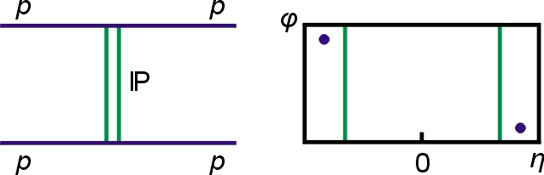
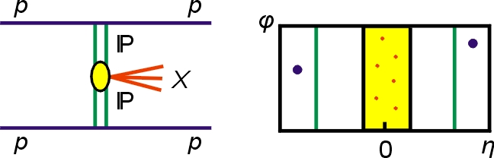
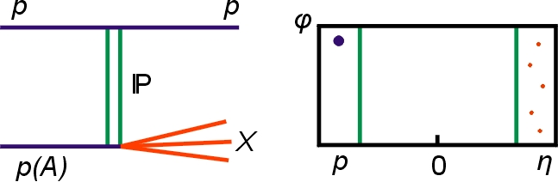
Physics with Tagged Forward Protons
QCD color singlet exchange: C=+1, C=−1
azimuthal
rapidity
p + p → p + X + p
Double Pomeron Exchange (DPE)
diffractive X= particles, glueballs
Discovery Physics
p + p → p + p
elastic
Single Diffraction Dissociation (SDD)
Notes:
3

Slide 4
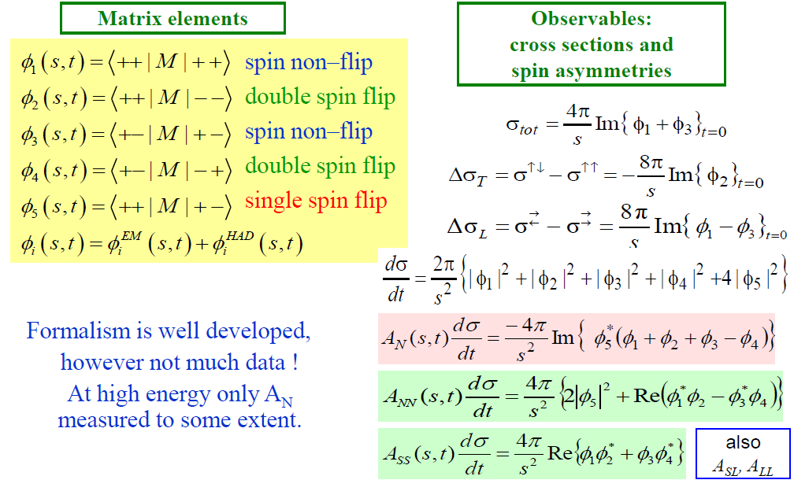
Helicity amplitudes for spin ½ ½ → ½ ½

Slide 5
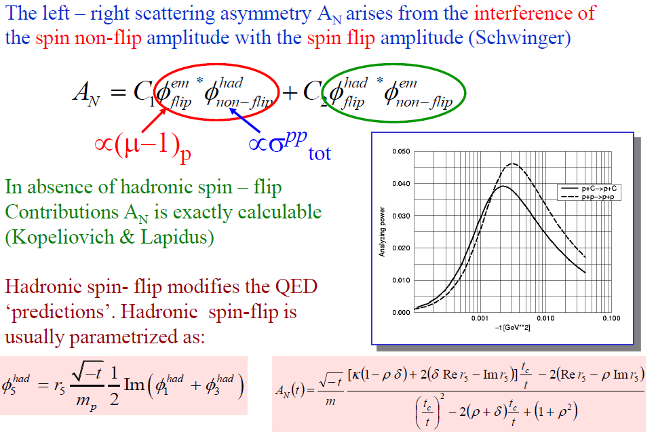
A_{N} and Nuclear Coulomb Interaction
In the absence of hadronic spin-flip contributions, A_{N} is exactly calculable. [Kopeliovich & Lapidus, Sov. J. Nucl. Phys. 19, 114 (1974).]
Our data reach
N.H. Buttimore, et al., Phys. Rev. D 59 (1999) 114010.

Slide 6
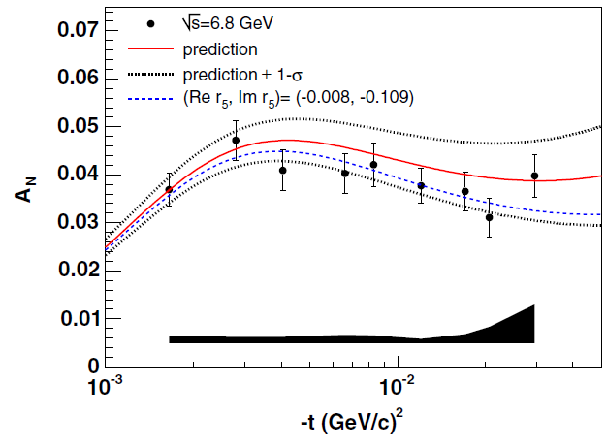
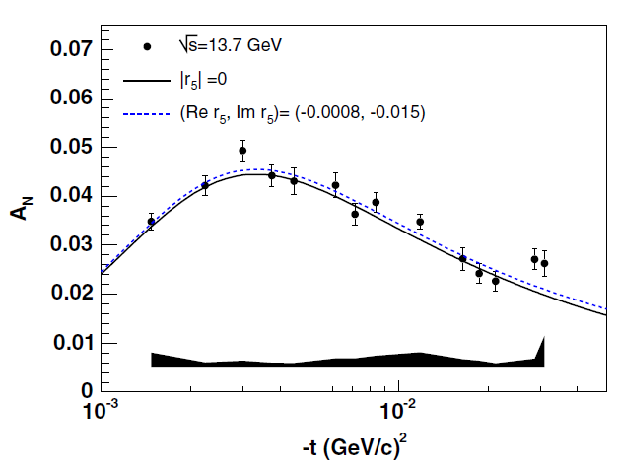
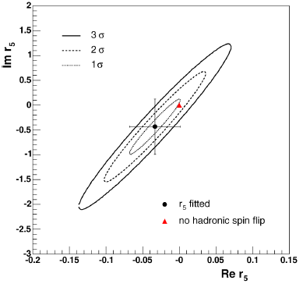
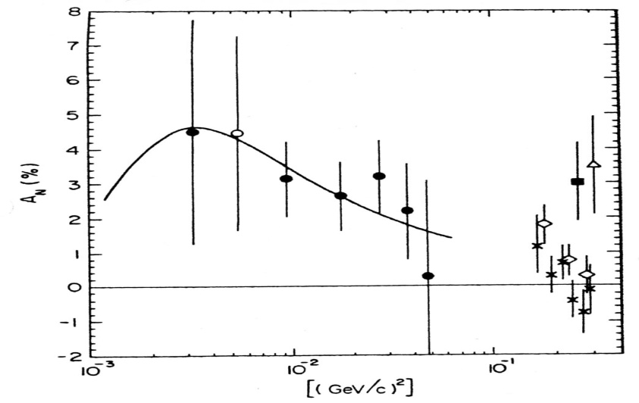
Previous A_{N} measurements in the CNI region
with hadronic
spin-flip
no hadronic
spin-flip
HJet@RHIC
PRD79(09)094014
HJet@RHIC
PRD79(09)094014
no hadronic
spin-flip
E704@FNAL
√s = 19.4 GeV
PRD48(93)3026
pp2pp@RHIC
√s = 200 GeV
PLB632(06)167
no hadronic
spin-flip

Slide 7
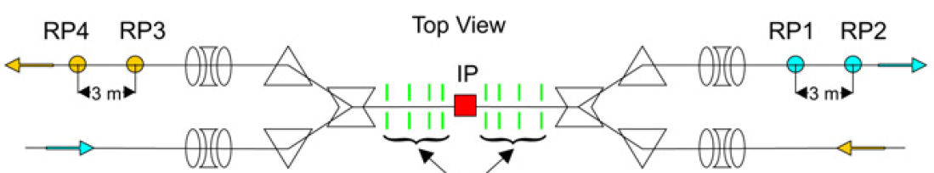
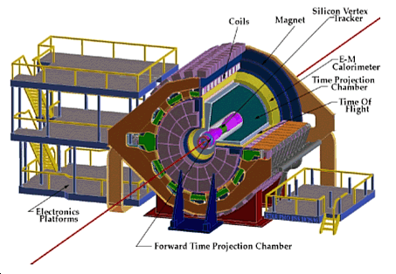
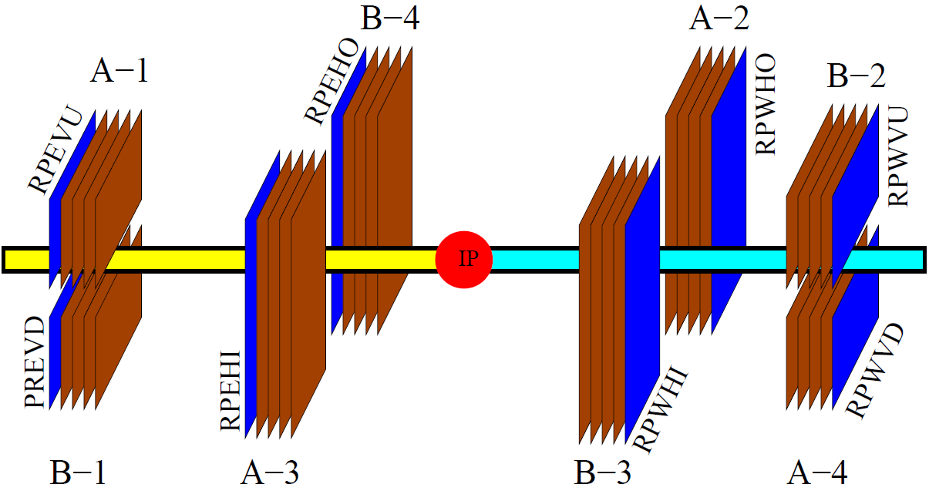
Implementation at RHIC − Detectors
Vertical (-58 m) Horizontal (-55 m)
IP (STAR)
Horizontal (55 m) Vertical (58 m)
Silicon pitch is ~100 μm

Slide 8
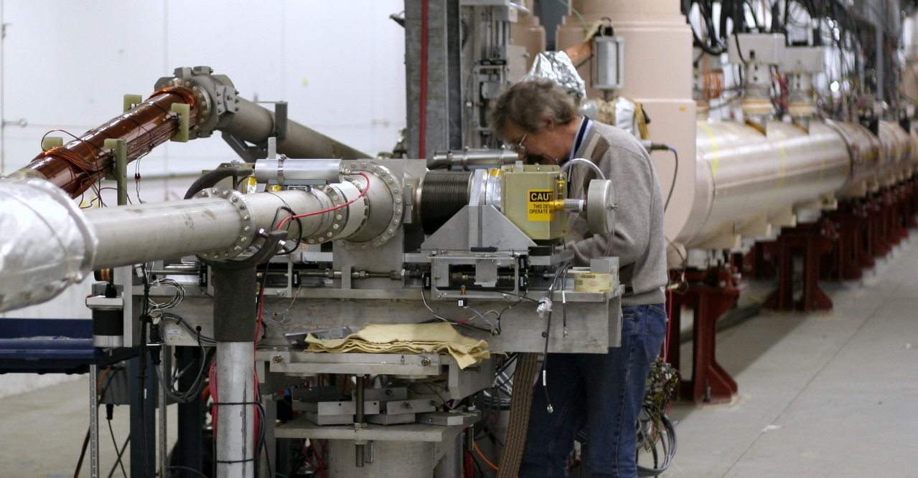
Roman Pots (RP) moved to STAR
Vertical and Horizontal RP setup for a complete φ coverage

Slide 9
Roman pots and transport
Scattered protons have very small transverse momentum and travel with the beam through the accelerator magnets
Roman Pots (RP) allow to get very close to the beam without breaking accelerator vacuum (~ 12 σ)
Optimal detector position is where scattered particles are already separated from the beam and their coordinate is most sensitive to the scattering angle through the machine optics
Beam transport equations relate measured position at the detector to scattering angles :
The most significant matrix elements are L_{eff}’s ,
so that approximately :
x_{D} ≈ θ_{x}*
y_{D} ≈ θ_{y}*
x
θ_{x}
y
θ_{y}
a₁₁ a₁₃ a₁₄
a₂₁ a₂₂ a₂₃ a₂₄
a₃₁ a₃₂ a₃₃
a₄₁ a₄₂ a₄₃ a₄₄
x*
θ_{x}*
y*
θ_{y}*
D
IP

Slide 10
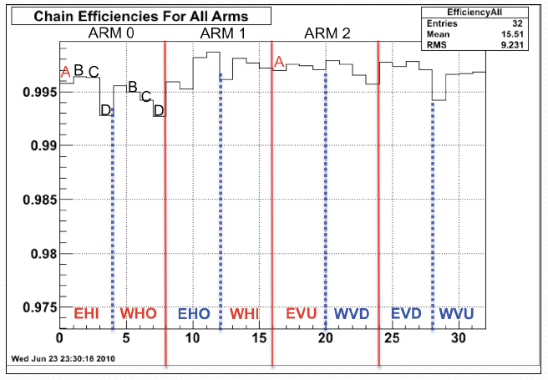
  Silicon Detector Performance in the 2009 run
After excluding (3) edge strips and hot/dead strips
Only 5 dead/noisy strips per ~ 14000 active strips (active area limited by acceptance)
Overall plane efficiency > 99%.
Excellent detector efficiencies allow us to have clean data.

Slide 11
  2009 run and main Selection Cuts
Data was taken in 5 days ~July 2009 >70 million triggers
Elastically triggered ( ~33 million events)
Outside sequencer (DAQ) reset time window
Valid hit/strip with ADC ⟩ pedestal_per_channel + 5 σ
A Cluster: ≤5 valid consecutive hits with ADC sum separated from the pedestal (depending on size)
Clusters in A/C and B/D strips are within < 200 μm (2 strips)
A track on each side (a track is formed by at least a cluster on each Roman Pot)
Collinearity (between the scattering angles in the East and West)
Timing-vertex cut
Fiducial cuts and getting rid of hotspots in the RP’s nearest to the beam (~tail of the beam)
⇒ ~21 million events (before considering the spin combinations)

Slide 12
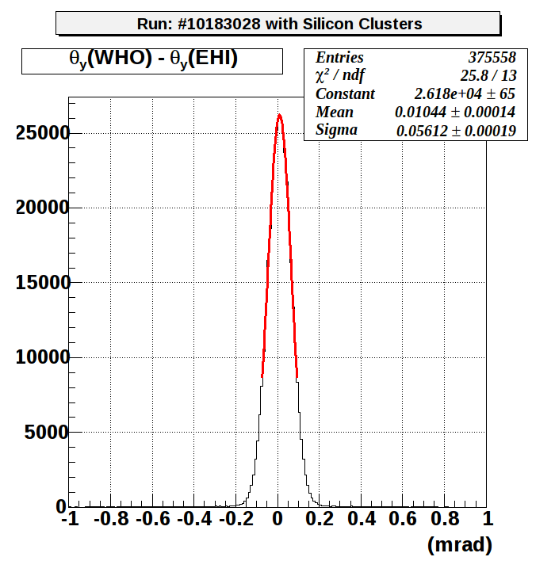
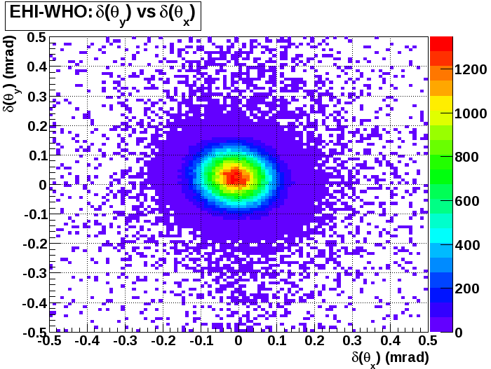
Collinearity cuts – mean & σ (position) determined from each run
A typical distribution of δ_{x} = δ[θ_{x}(West) − θ_{x}(East)] and δ_{y} = δ[θ_{y}(West)- θ_{y}(East)] for a run is shown here.
Width here is consistent with the beam divergence.

Slide 13
Calculation of single-spin asymmetry A_{N}
Square root formula: don’t need external normalization, acceptance asymmetry and luminosity asymmetry cancel out
We have all bunch polarization combinations: ↑↑, ↑↓, ↓↑, ↓↓
  →can build various asymmetries
Both beams polarized – half of the statistics, but effect ~ (P_{B}+P_{Y})
One beam polarized, the other ‘unpolarized’ – full statistics, but effect is only ~P_{B} (or P_{Y})
Opposite relative polarization – effect
~ (P_{B}–P_{Y}) should be close to 0 – systematics check
where
and ϕ is the azimuthal angle.
Beam polarization*: P_{B}= 0.604±0.026 and P_{Y}= 0.618±0.028
(P_{B}+P_{Y}) = 1.224 ± 0.038, (P_{B} – P_{Y}) = –0.016 ± 0.038 = 0.013(P_{B}+P_{Y})
and there is an additional global error ~ 4.4% on (P_{B}+P_{Y}).
*Averaged for our fills from the official Run’09 CNI polarimeter results http://www4.rcf.bnl.gov/~cnipol/pubdocs/Run09Offline/

Slide 14
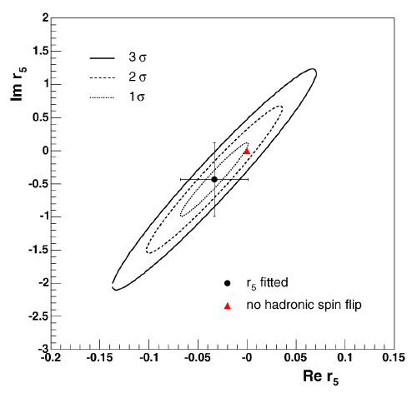
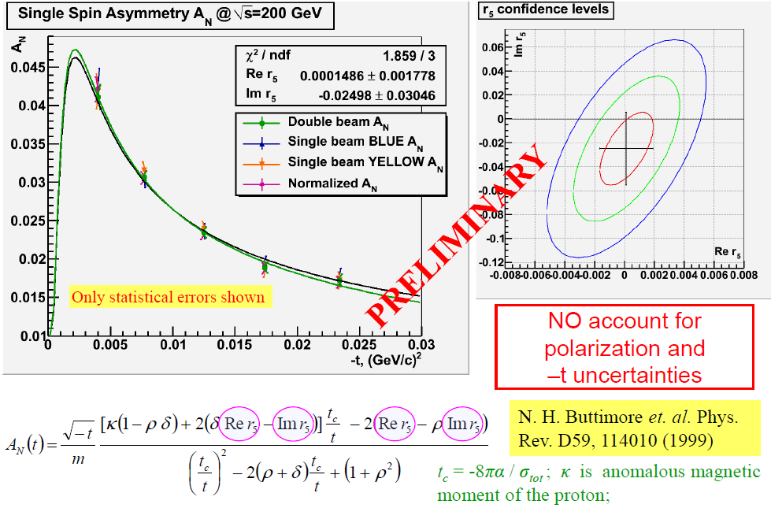
Preliminary results on A_{N} and r₅
cf. p. 6, much more accurate than our previous meas. !
3 σ
Our fit
2 σ
1 σ
no hadronic
spin-flip
STAR

Slide 15
Finalizing the analysis …
We have focussed our efforts to figure out the best and most accurate transport for the RHIC configuration that we have used during the 2009 run.
  Cross-checked the transport and the off-axis effects by established software such as MADX and Turtle (to arrive at the same result).
  Determined (eg.) the signs of angles and magnet strengths related to our experiment with the help of accelerator physicists and dedicated new/old beam experiments.
  Determining the best way to determine the scattering angle from positions in the RP’s (using MC simulation to tell us the accuracies).
We have spent a lot of time in alignment by detector position surveys in the RHIC tunnel and using the (over-)constraints from the elastic data to better align the detector geometry.
A lot of systematic checks have been done. Eg.:

Slide 16
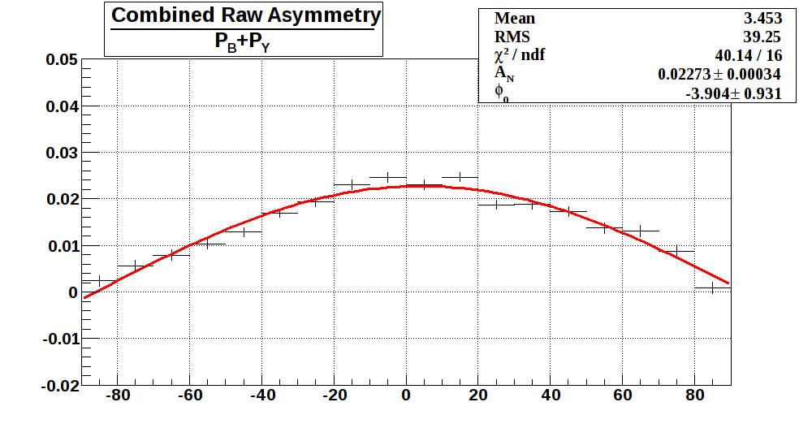
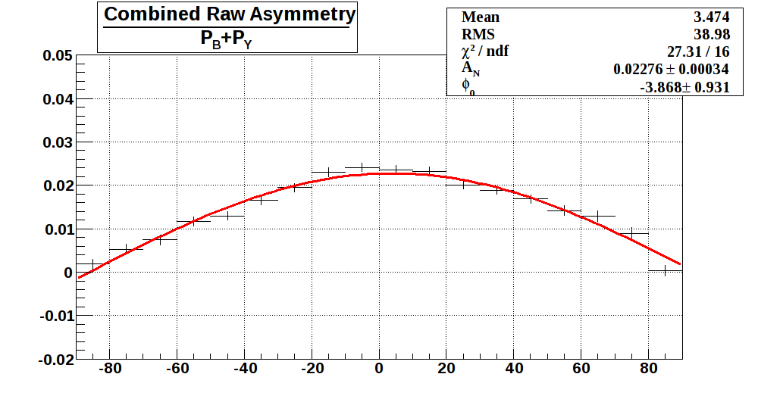
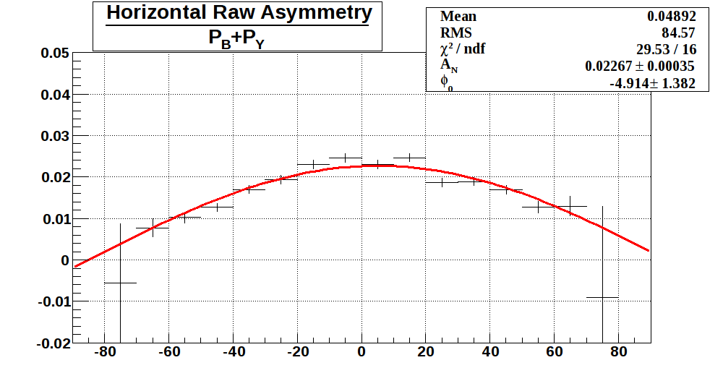
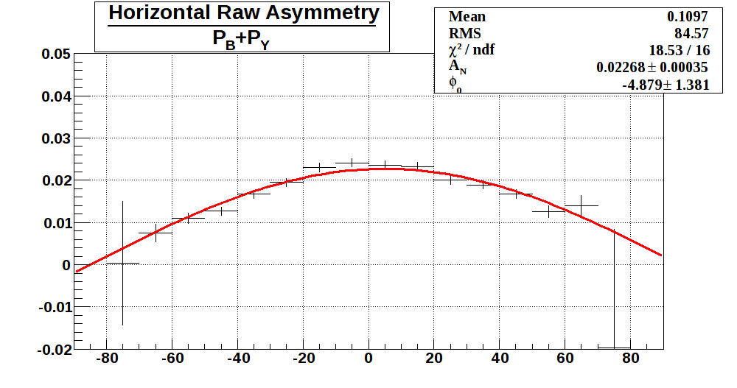
East Only (all –t)
West Only (all –t)
φ (°)
φ (°)
φ (°)
φ (°)

Slide 17
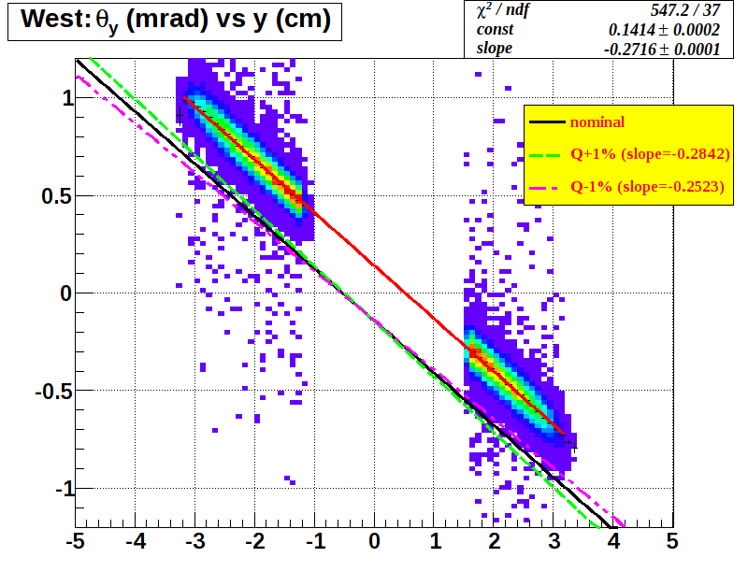
A check to show that we understand the optics of our system:
We compare the slope of the straight line fit of the angle θ(RP) vs the coordinates(RP) obtained from the data to the slopes of the fits in Turtle simulations when we vary the quad. strength. Our knowledge of the magnetic strength is better than 1%.
(Turtle)
(mrad)
(cm)

Slide 18
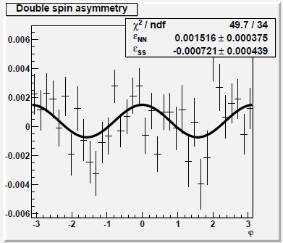
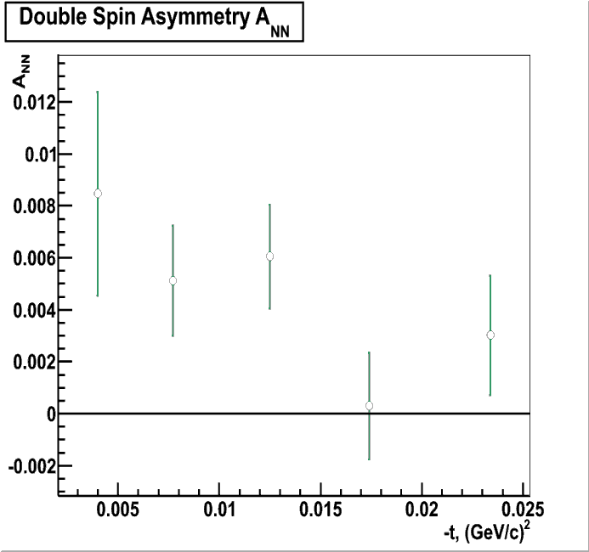
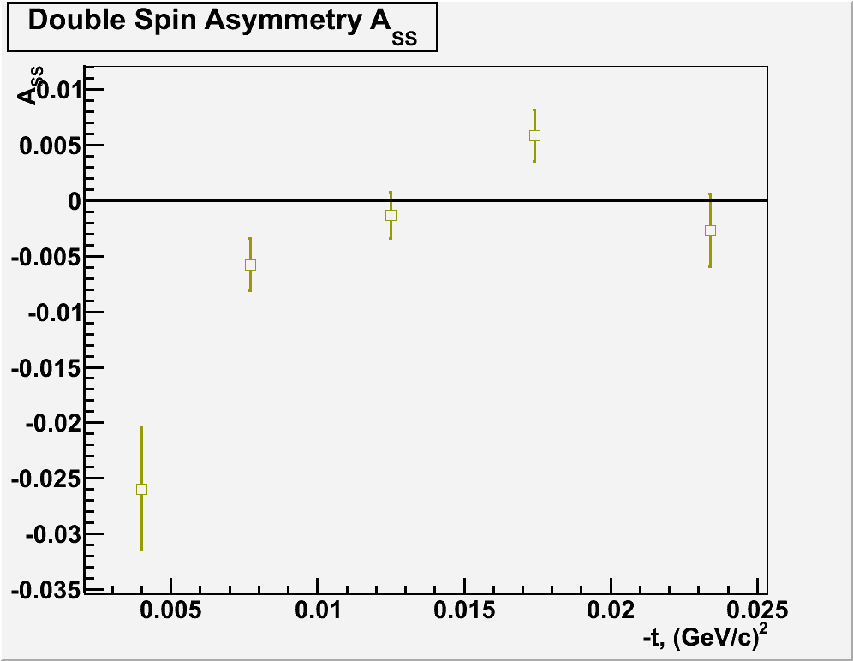
A_{NN} and A_{SS}
Cannot use square root formula – have to rely on normalized counts K^{+/–}
Double spin effects are seen but very small
STAR PRELIMINARY
All -t-ranges
A_{NN}
A_{SS}
Both A_{NN} and A_{SS} are very small ~10^{–3} (except for the lowest t-range where larger systematic shifts may occur)
Need better systematic error studies – current normalization uncertainties are of the order of the effect
Large systematic shift of 0-line is possible due to normalization
STAR PRELIMINARY
STAR PRELIMINARY

Slide 19
To summarize:
>20 million good elastic events recorded in 5 days of data taking with RP’s in 2009 at √s=200 GeV and special machine optics β*=21 m.
Currently, we’re trying to optimize the way to determine scattering angles from positions in RP’s and complete the systematic studies.
Upon completion, we should have the most precise measurement of A_{N} in this energy range.
We’re preparing publication on A_{N} and r₅ and the knowledge gained is directly applicable to the other analyses:
  double-spin asymmetries A_{NN} and A_{SS}
  elastic scattering - spin averaged dN/dt => slope b etc.
  Planning a Phase II which may allow us to study diffractive physics (Central Production, Single Diffraction Dissociation and its spin dependence) and exotic physics etc.
The pp2pp program at STAR helps explore physics potential and discovery possibilities at RHIC.

