Slide 1


PHENIX Highlights
Edouard Kistenev
PHENIX at RHIC

Slide 2
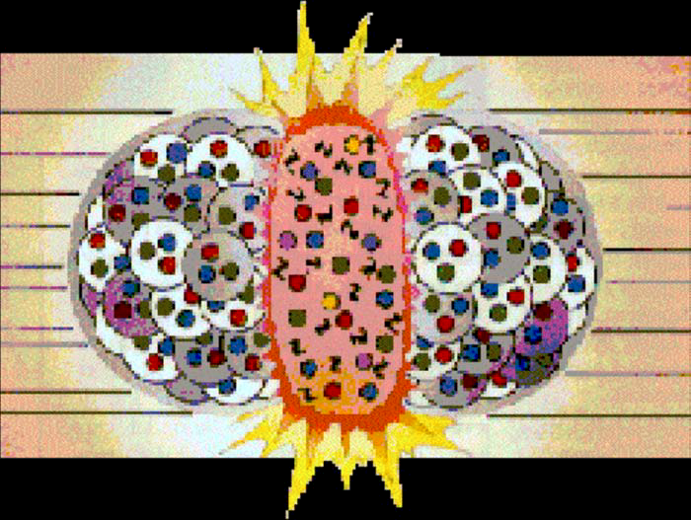
High Energy Nucleus-Collisions provide the means of creating Nuclear Matter in conditions of Extreme Temperature and Density
At large energy and/or baryon density, a phase transition is expected from a state of nucleons containing confined quarks and gluons to a state of “deconfined” (from their individual nucleons) quarks and gluons covering a volume that is many units of the confinement length scale.

Slide 3
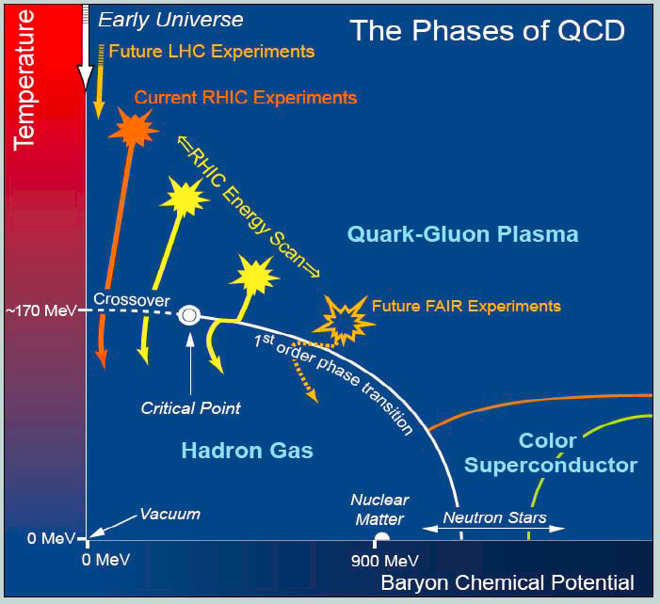
The Quark Gluon Plasma (QGP)
• The state should be in chemical (particle type) and thermal
equilibrium <pT> ~T
• The major problem is to relate the thermodynamic properties:
Temperature, energy density, entropy of the QGP or hot nuclear
matter
to properties that can be measured in the lab.

Slide 4
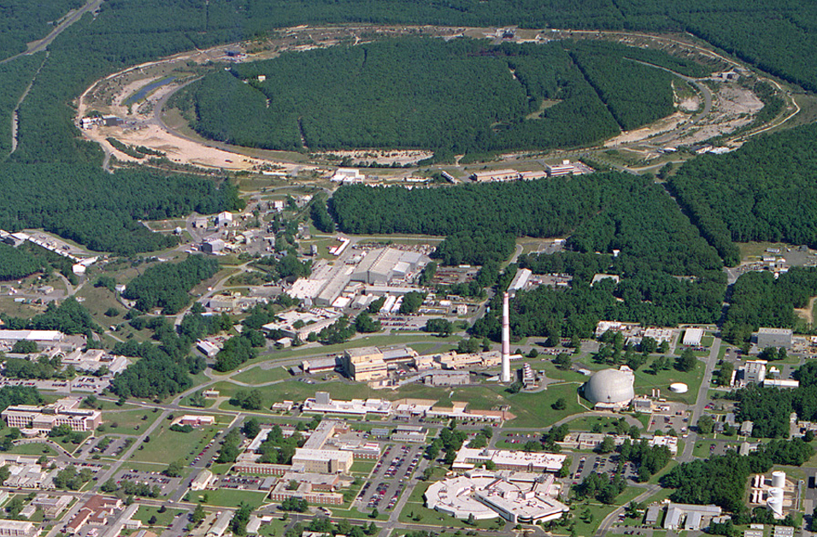
Relativistic Heavy Ion Collider
1 of 2 ion colliders (other is LHC), only polarized p-p collider
(PHOBOS)
10:00 o’clock
Jet Target
12:00 o’clock
RHIC
AnDy
2:00 o’clock
PHENIX
8:00 o’clock
RF
4:00 o’clock
STAR
6:00 o’clock
LINAC
NSRL
Relativistic Heavy Ion Collider
2 superconducting 3.8 km rings
2 large experiments
100 GeV/nucleon Au
250 GeV polarized protons
Performance defined by
  1. Luminosity L
  2. Proton polarization P
  3. Versatility (Au-Au, d-Au, Cu-Cu, polarized p-p (so far) 12 different energies (so far)
EBIS
Booster
AGS
Tandems
Erice 2011

Slide 5
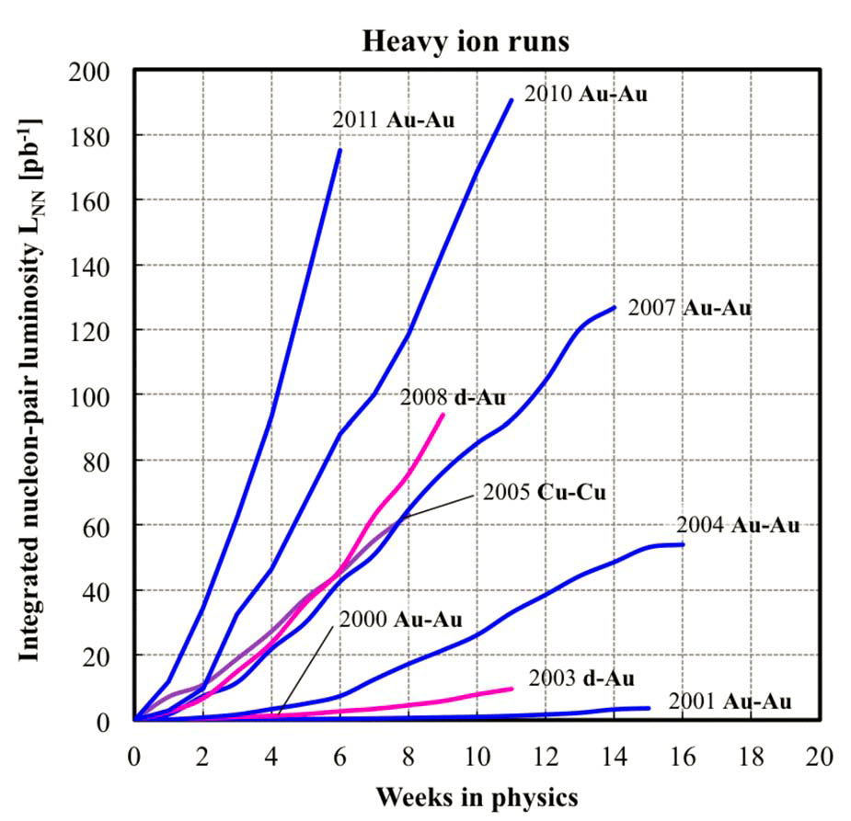
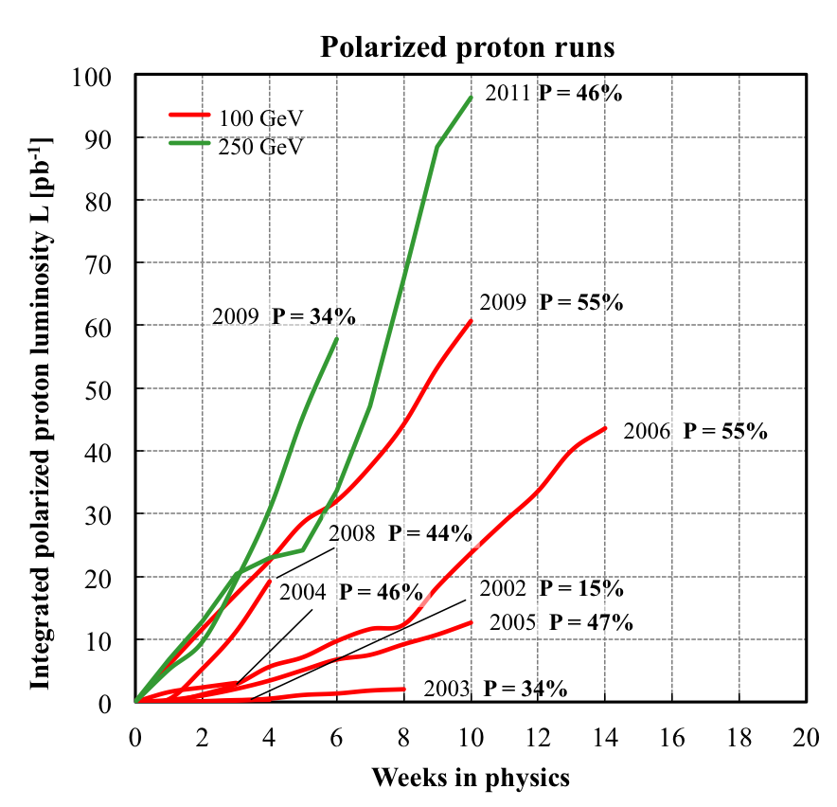
RHIC luminosity evolution to date
L_{NN} = L N₁ N₂ (= luminosity for beam of nucleons, not ions)
<P> increased from 37%
to 46% at 250 GeV in Run-11
still significant effort needed
to reach goal of 70%
<L> = 15x design in 2011
About 2x increase in Lint/week each
Rate of progress will slowdown – burn off 50% of beam in collisions already

Slide 6
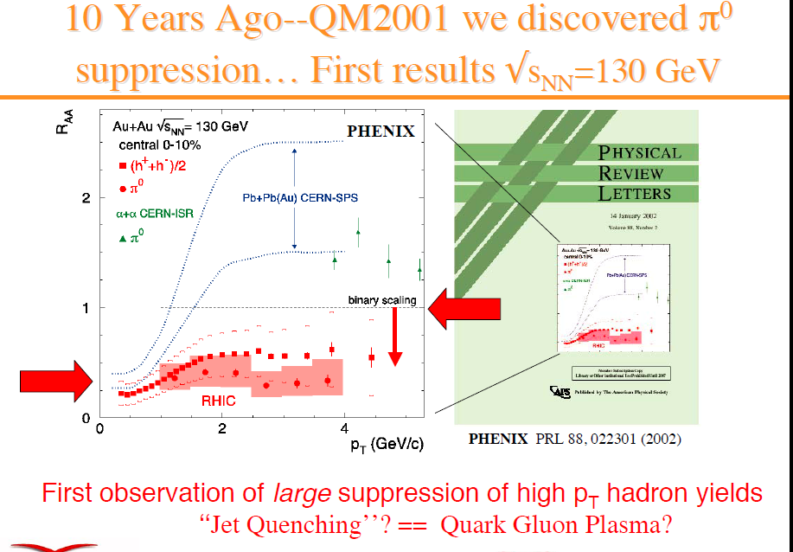

Slide 7
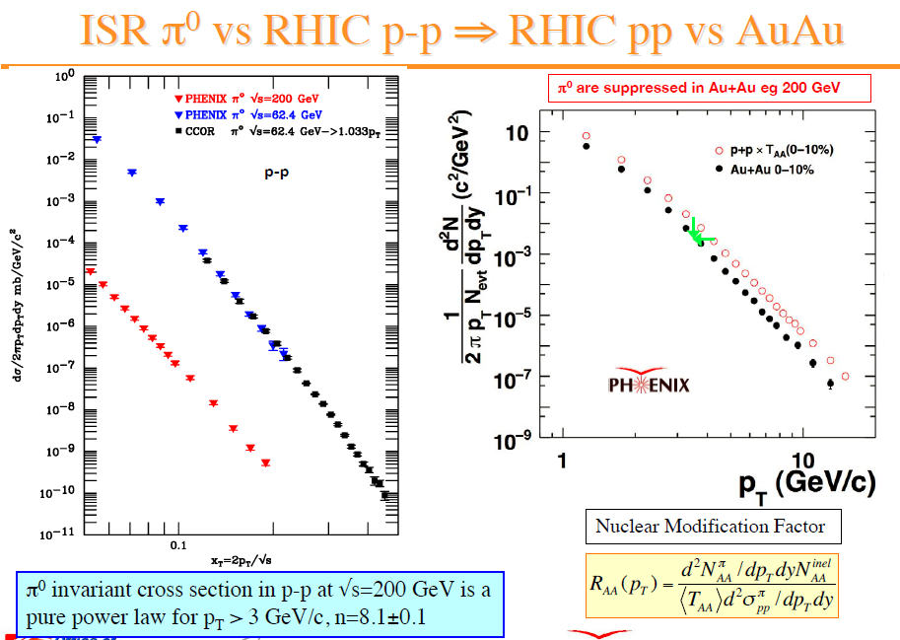

Slide 8
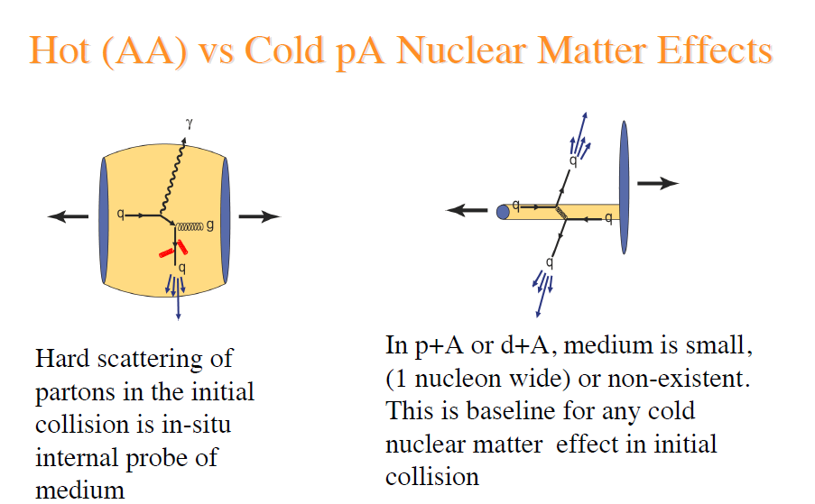

Slide 9
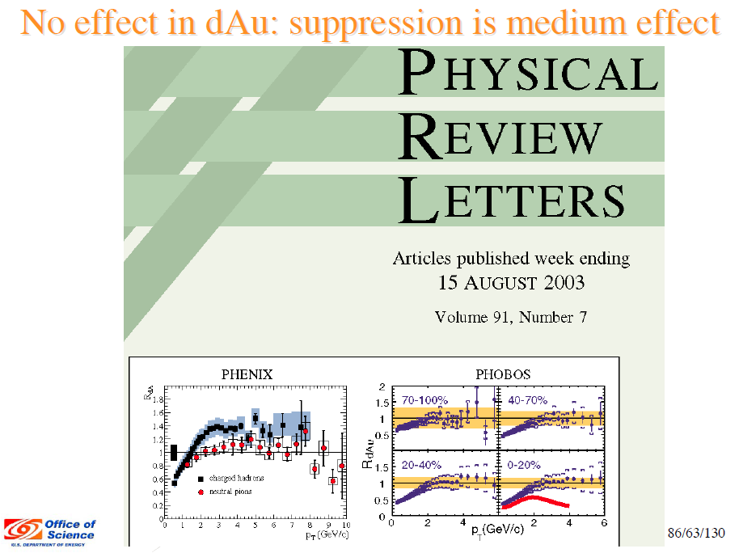

Slide 10
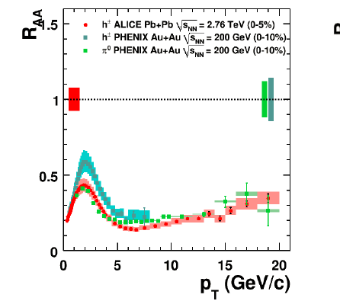
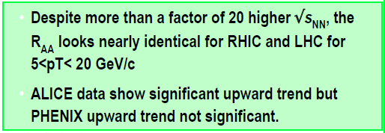
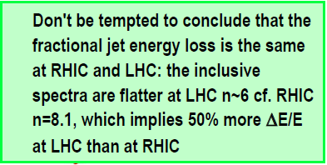
Ten years later (Десять лет спустя)

Slide 11
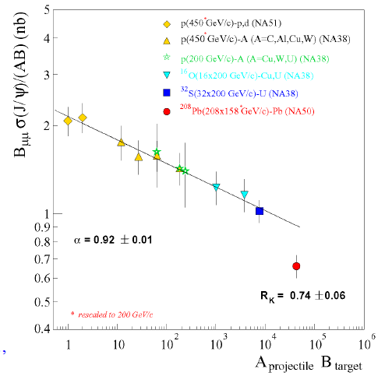
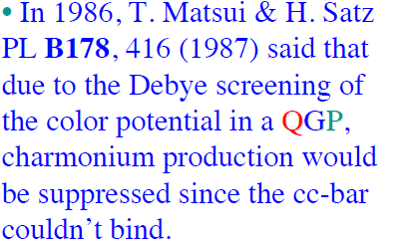
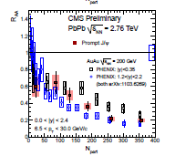
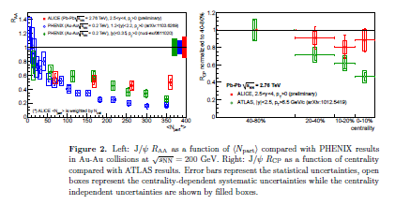
Ten years later (Десять лет спустя)
Golden signature of QGP
Comparison to ALICE & CMS at LHC

Slide 12
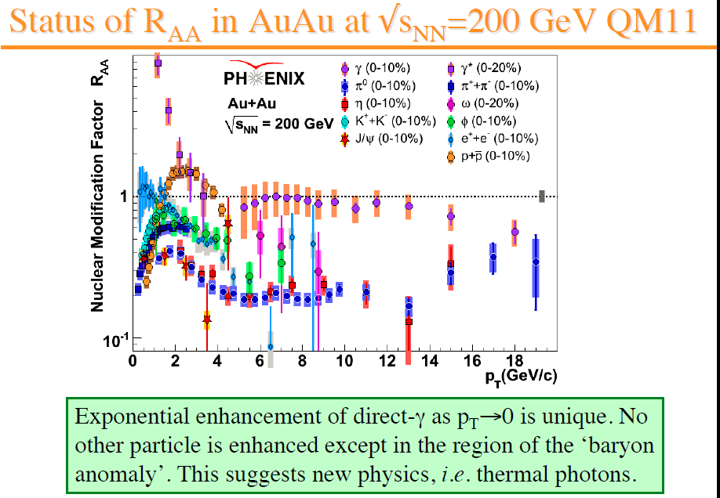

Slide 13
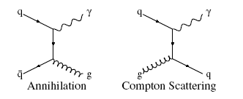
Direct (prompt) photons
30% of energy released when two particles collide are photons;
Most are tertiary, they are products of electromagnetic decays of secondary hadrons and leptons;
Some are direct – produced in partonic hard scattering, emitted by fragmenting partons or by media during freeze out;
Those due to hard scattering are also called prompt, their production in NN interactions is well studied and commonly used as a proof of validity for pQCD treatment

Slide 14
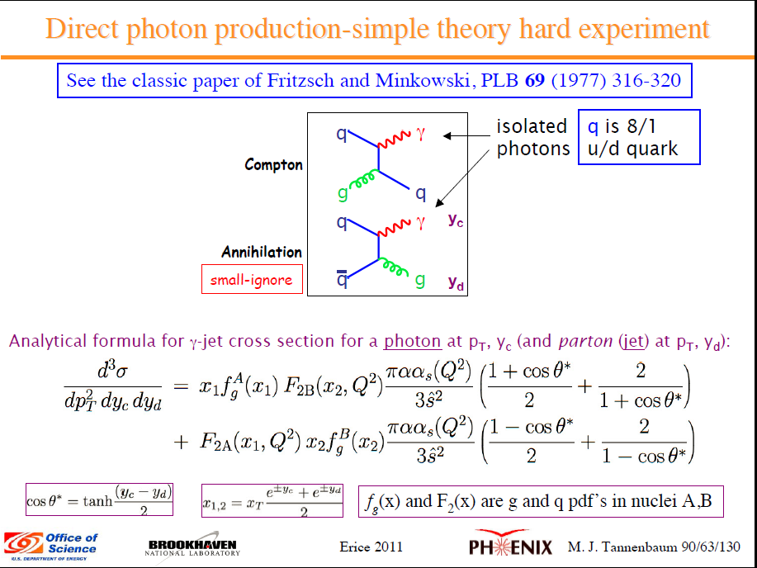

Slide 15
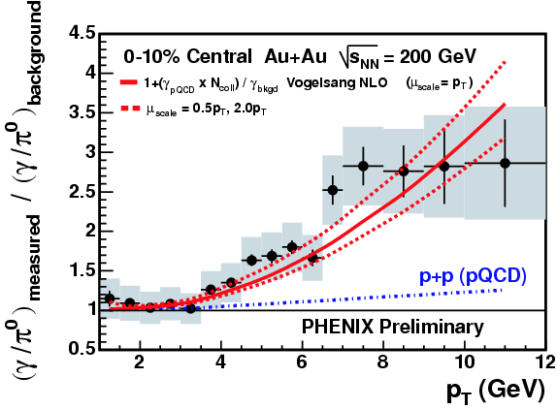
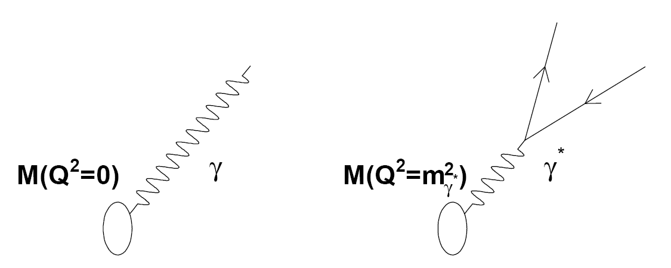
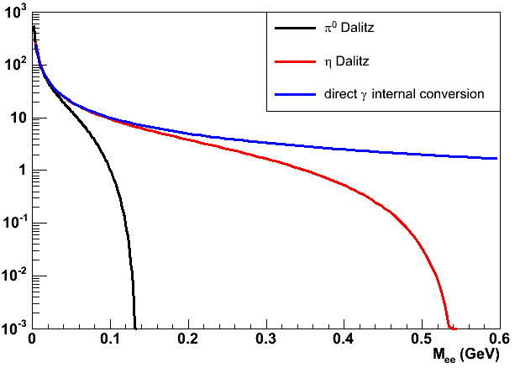
Direct photons – real and virtual
Nature to the resque
Typically direct photons are small “excess” above hadron decay photons in the total inclusive yield
Statistical approach: measure inclusive photons and subtract hadronic (decay) component
Real photon yield can be measured from virtual photon yield, which is observed as low mass e⁺e⁻ pairs
Huge γ/π⁰ ratio at high pT reflects high-pT hadron (π⁰) suppression in AuAu central collisions
Direct γ
Excess at low p_{T} is less then 15% so precision measurements of direct photon yield in thermal reagion are notoriously difficult
η

Slide 16
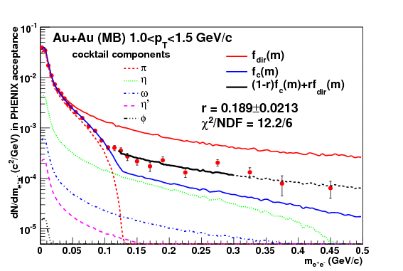
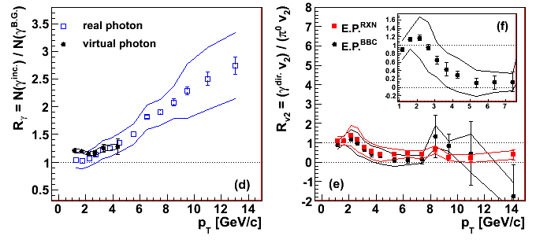
Virtual photons (internally converted)
Relation between the γ* yield and real photon yield is known (Kroll-Wada formular in case of hadrons (π⁰, η), equality in case of direct photons)
where
One parameter fit: (1-r)f_{c} + r f_{d} here f_{c}: cocktail calc., f_{d}: direct photon calc.

Slide 17
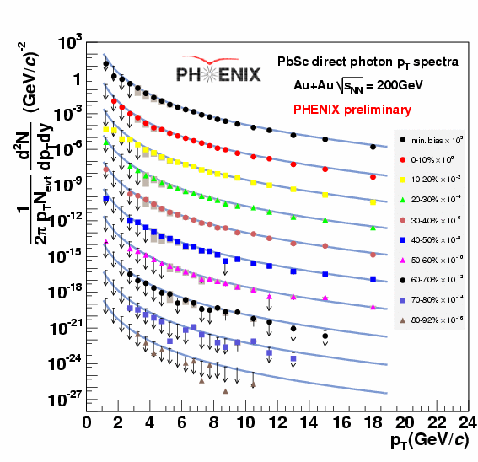
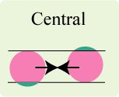
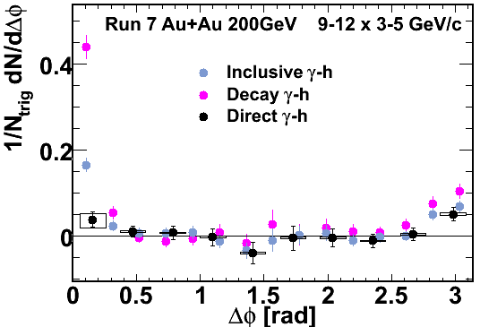
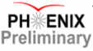
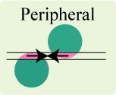
Direct photons in AuAu 200 GeV
Curves: collision scaled pp direct γ yield
Photons in calorimeters
2001-2010
Hard prompt photons are isolated
collision scaling works in AuAu

Slide 18
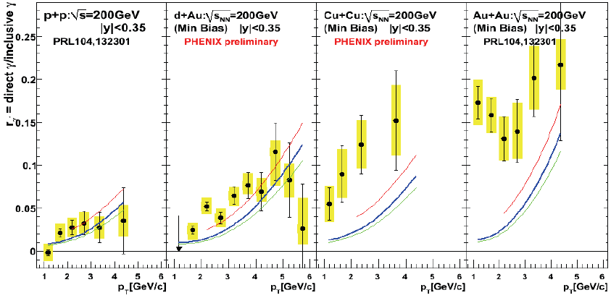
Emerging thermal γ’s
Virtual photon measurement helped to extend pT range down to
~1 GeV/c and establish thermal dominance in the direct γ yield below pT~5 GeV/c
first reliable sighting of thermal enhancement

Slide 19
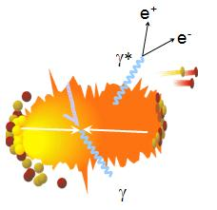
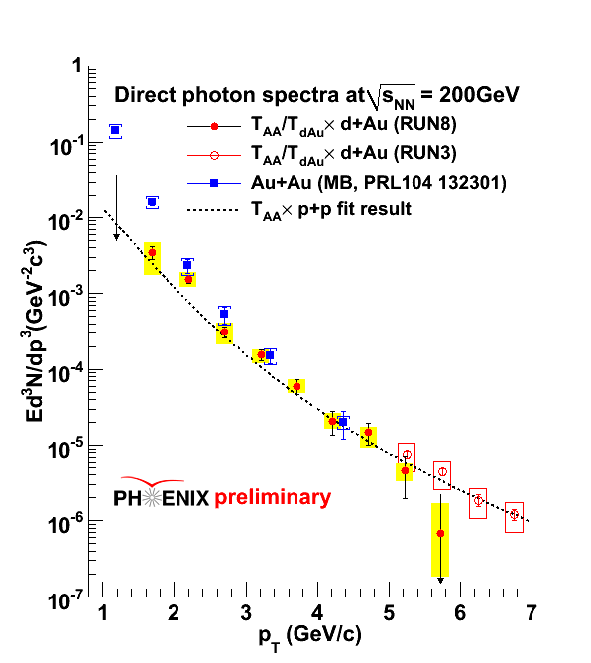
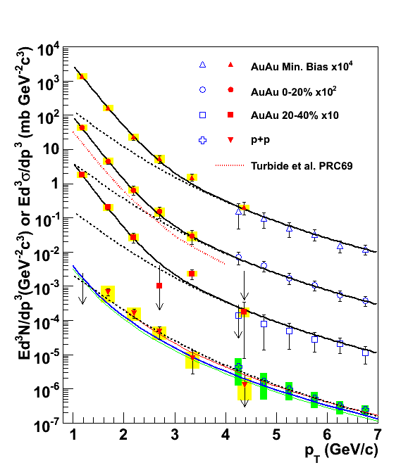
Thermal enhancement
π
π
g
q
Exp fit to Au+Au data / scaled pp data:
T_{ave} = 221 ± 19^{stat} ± 19^{syst} MeV
ρ
γ
q
γ
experimental lower bound on T
Min. Bias
T_{ini} = 300 to 600 MeV
t₀ = 0.15 to 0.5 fm/c
PRL104,132301(2010), arXiv:0804.4168

Slide 21
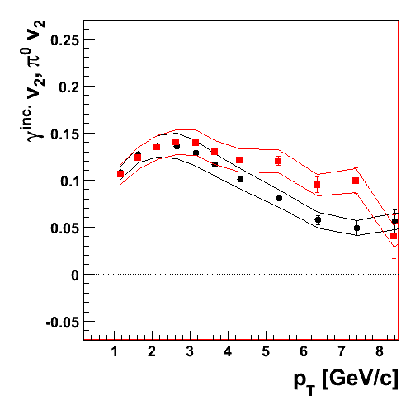
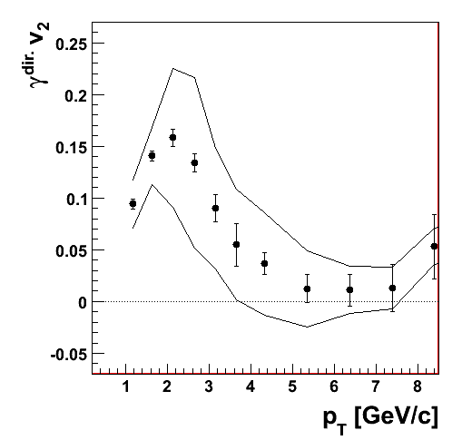
Thermal photons and thermalization time
Thermal photon dominate below pT~ 5 GeV/c;
Theory is uncertain about equilibration time (t₀) and temperature (T₀) when hydro reigns, recent estimates vary from 0.15 fm/c – 600 MeV to 0.5 fm/c – 300 MeV;
PHENIX: T_{thermal} = 221 ± 19^{stat} ± 19^{syst} MeV
Au+Au@200 GeV
minimum bias
Au+Au@200 GeV
minimum bias
arXiv:1105.4126
π⁰ v₂
If photons are radiated inside an expanding matter having v2, their momenta add or subtract for radiation along or opposite to the motion. Neglecting pion mass, thermal photons must have the same or greater v2 as pions , if it comes from this mechanism.
BKopeliovich (pr. comm.)
Direct photons
inclusive photons
(thermal are ~10%)
late thermalization or preequilibrium emission ?
Notes:
Add formular explaining additive V2

Slide 22
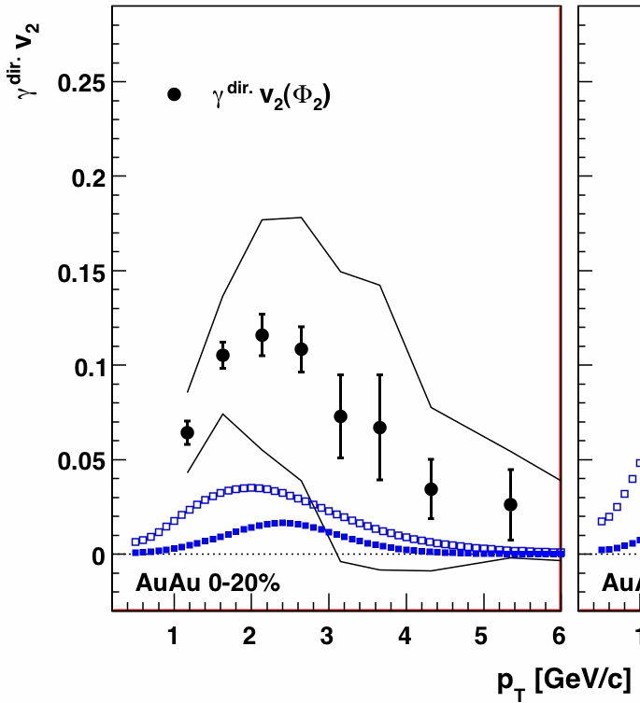
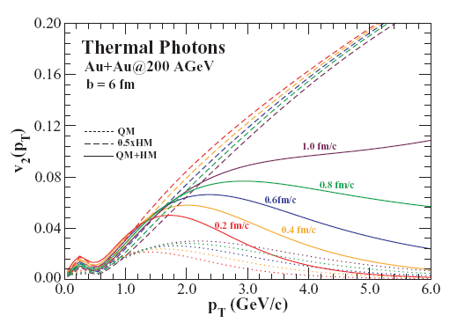
Direct photon flow: from intuition to theory
Hydro after τ₀
arXiv:1105.4126
Curves: Holopainen, Räsänen, Eskola
arXiv:1104.5371v1
2011
thermal
diluted by prompt
Chatterjee, Srivastava PRC79, 021901 (2009)
Pattern is right, scale can now be tuned to match
experiment

Slide 23
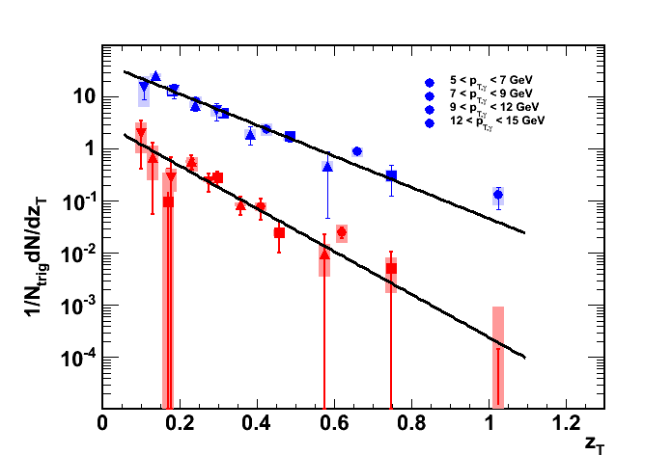
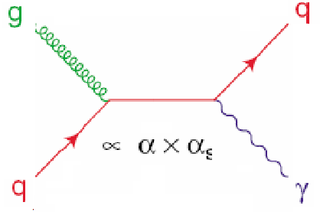
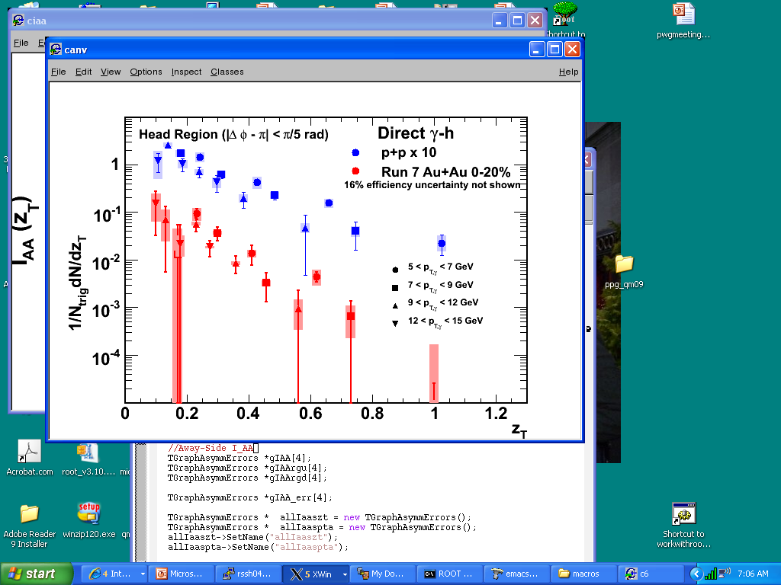
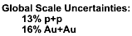
pQCD photons and partonic FF
Rate
6.89 ± 0.64
Hadron Gas Thermal
9.49 ±1.37
QGP Thermal
“Pre-Equilibrium” Thermal?
Jet Re-interaction ?
γ
hadrons
LO
E_{γ}
Notes:
No flow = no final state modifications
Ideal tool to study media modifications to fragmentation function. Would be ideal to tag jets by at least strangeness (gluon reach jets) but this is in future
AuAu is steeper but still is a very good nice power law fit.
Why in the hell jets are still power law

Slide 24
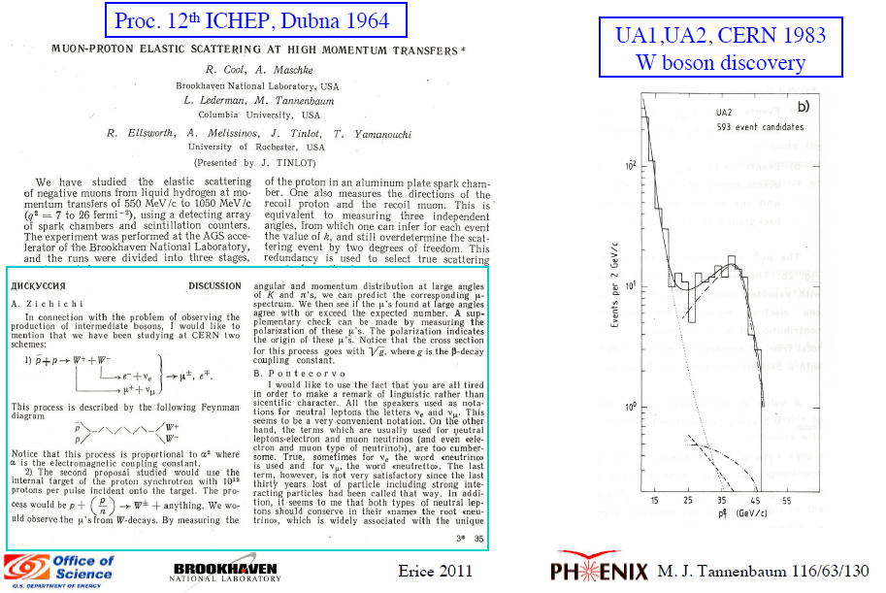
From direct photons to W±

Slide 25
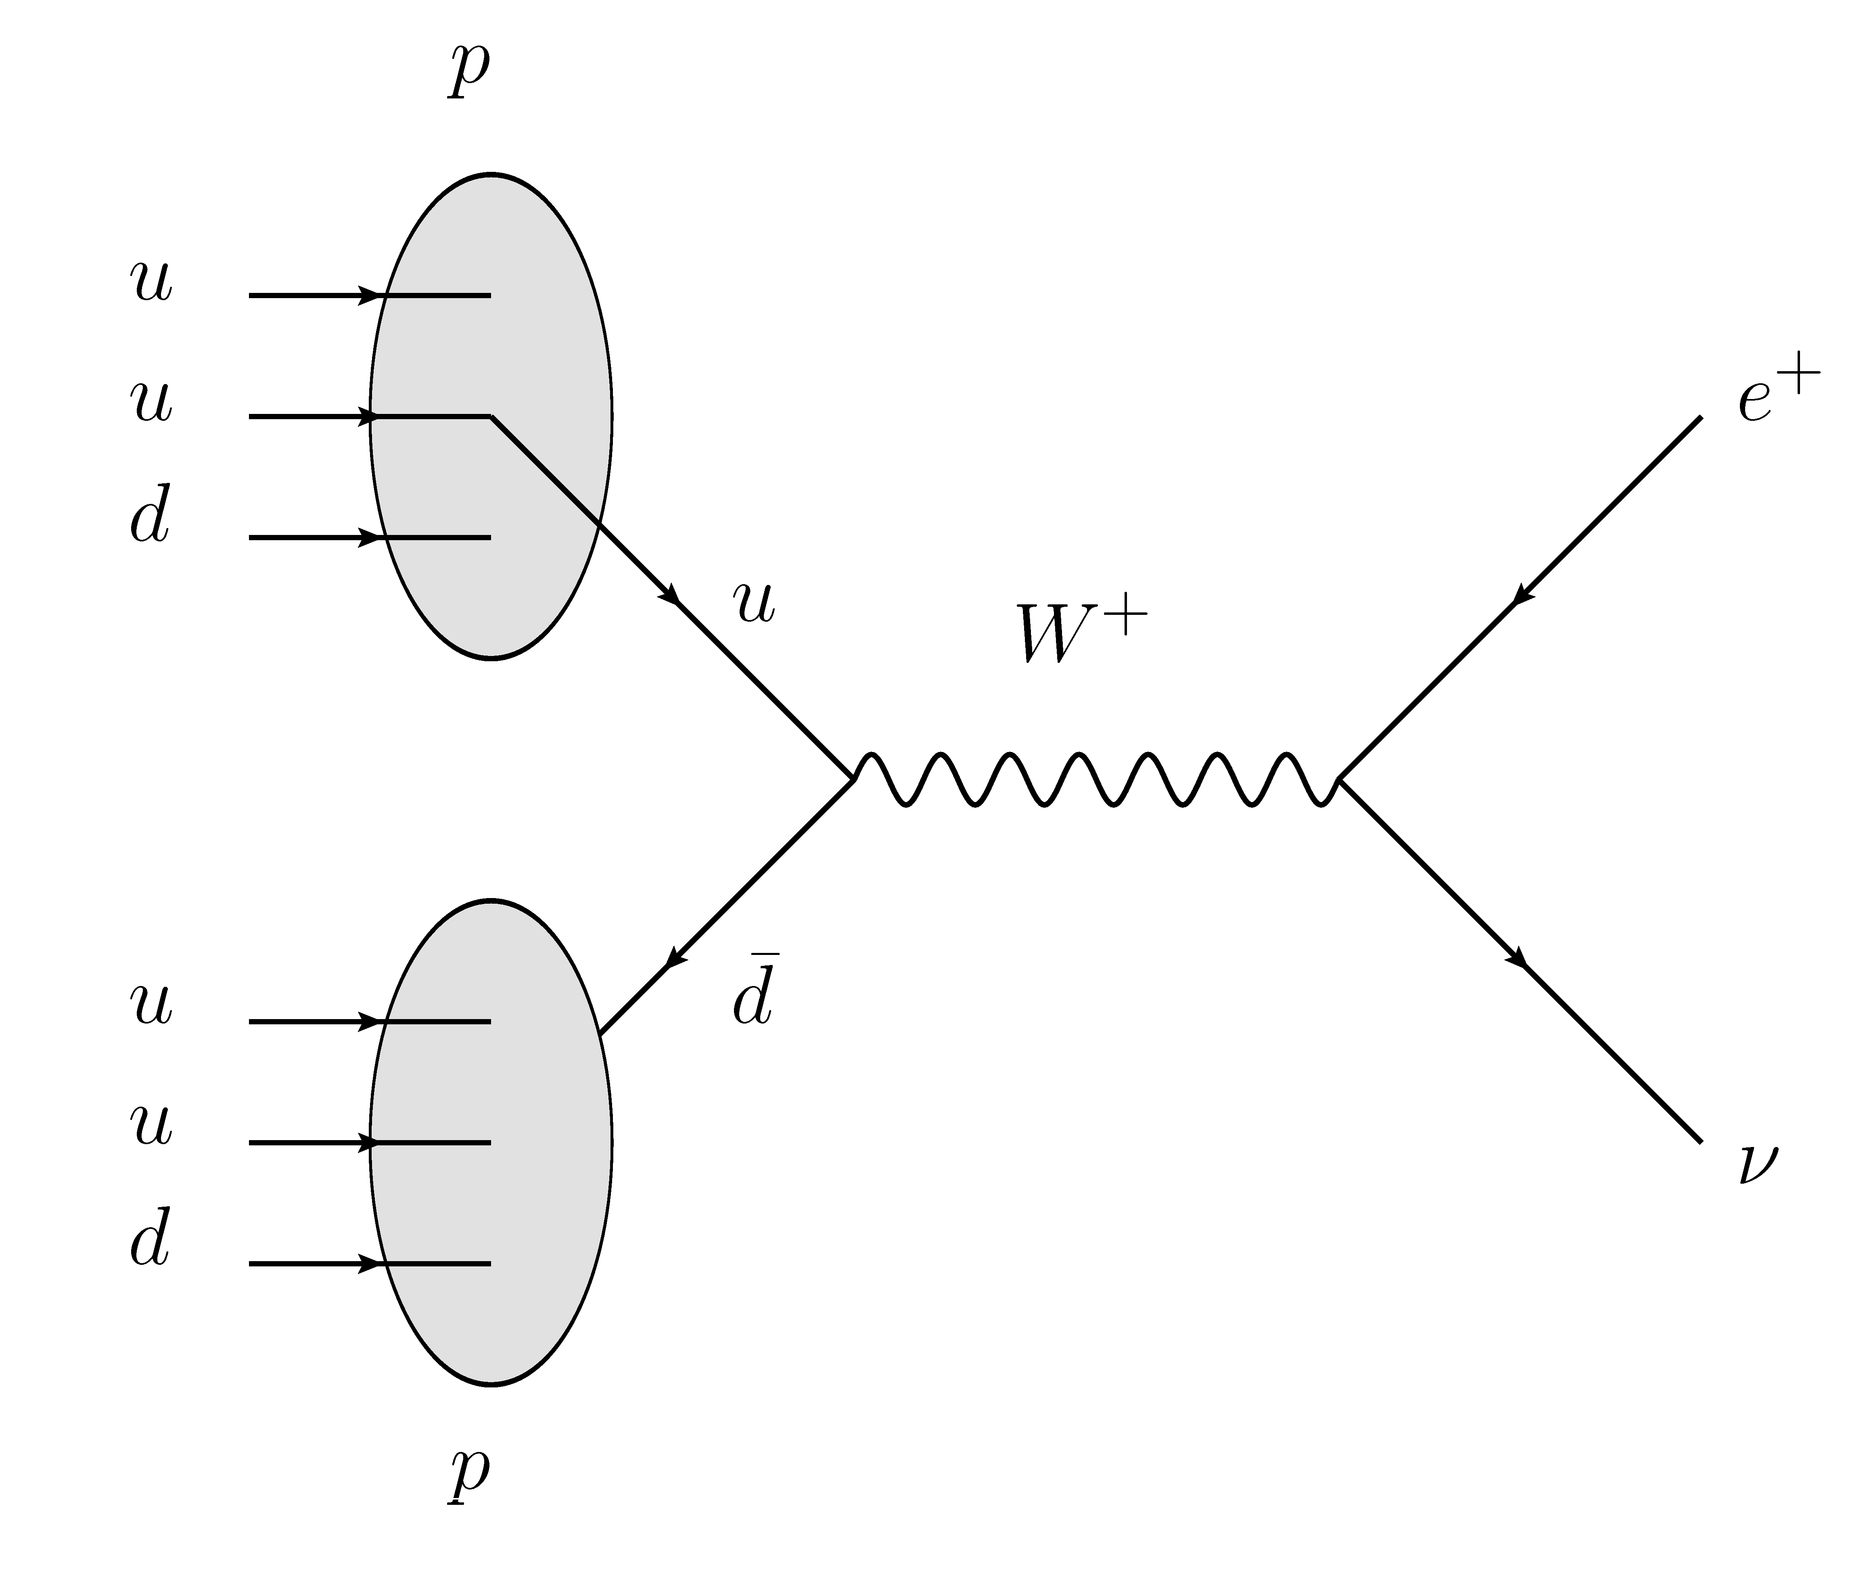
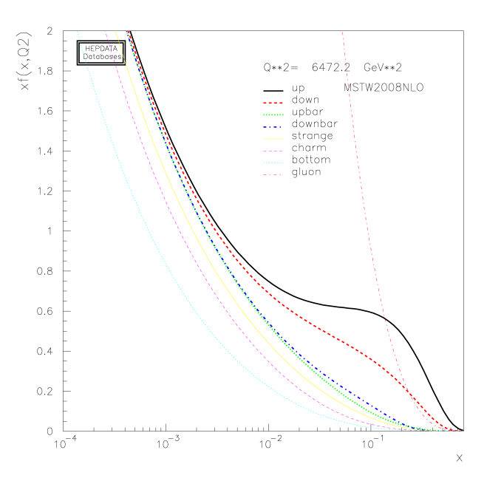
What can W at RHIC tell us?
The W± probes the quark distribution in pp
  Different PDF sampled than in pp
Access to polarized PDF’s through
  Cross section
  W⁺/W⁻ ratio
  Longitudinal spin asymmetry
Sensitivity is enhanced in forward production (free of kinematic ambiguities)
PDF at Q²=M_{W}²

Slide 26
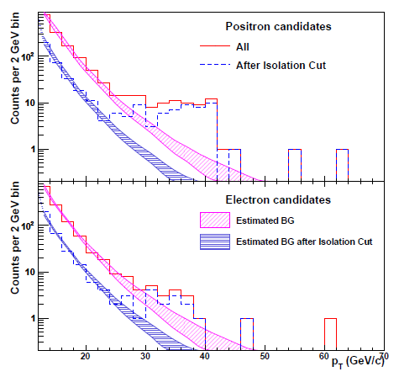
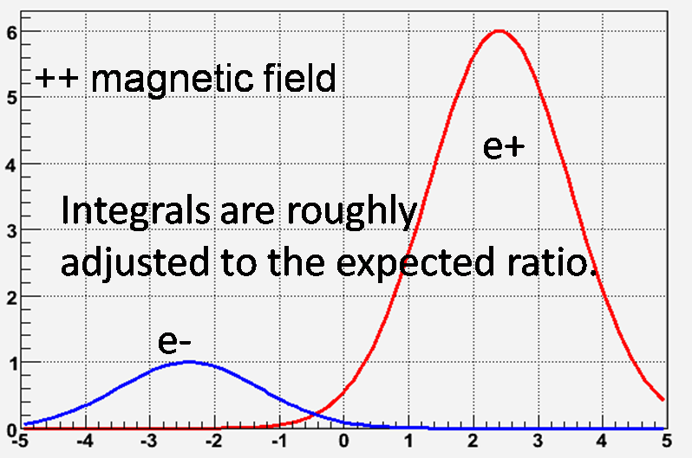
2009 e+/e- event selection (W-> e+ν)
±30 cm vertex cut
High energy EM Calorimeter clusters matched to charged track (PHENIX central arms)
Loose timing cut eliminates cosmic rays
Loose E/p cut
Residual charge uncertainties affect mostly e- sample
α = bend angle

Slide 27
Event sample 30<p_{T}<50 GeV/c
From 9.28 pb⁻¹ of data
Sample | Raw counts | Background counts | Background subtracted | Isolation cut counts
Positive | 60 | 11.1 | 48.9 | 39
Negative | 16 | 10.6 | 5.4 | 11
Total | 76 | 21.7 | 54.3 | 50

Slide 28
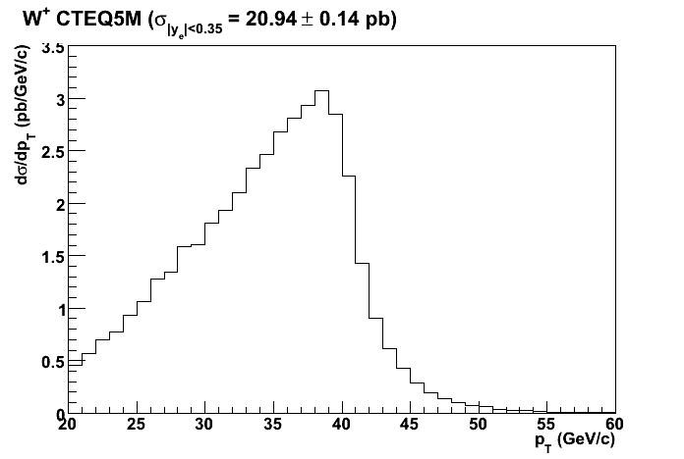
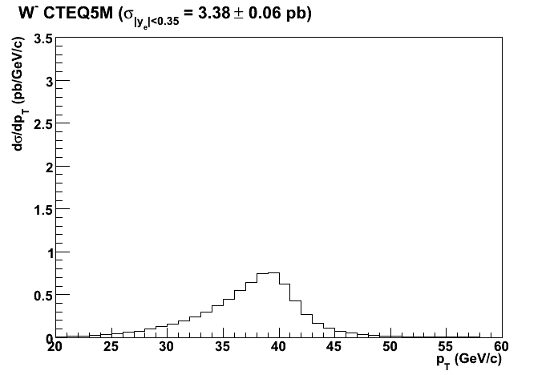
Cross section predictions
LO, NLO, and NNLO calculations exist
Soft gluon resummation important for central region
RHICBOS Monte Carlo includes spin dependent PDF’s
W⁺
W⁻
RHICBOS due to Nadolsky and Yuan, Nucl.Phys.B666:31-55,2003

Slide 29
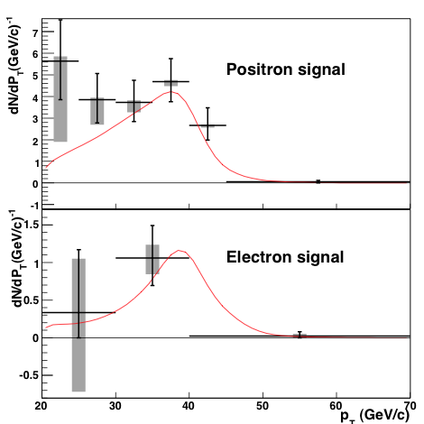
Background subtracted spectra of positron and electron candidates
Gray bands = range of background estimates.
Compared to spectrum of W and Z
decays from a NLO calculation
[D. de Florian and W. Vogelsang,
Phys. Rev. D81, 094020 (2010).
P. M. Nadolsky and C. P. Yuan,
Nucl. Phys. B666, 31 (2003)]
These yields were used for cross section results. For the asymmetry measurement, additional cuts were applied to make the background contribution negligible.

Slide 30
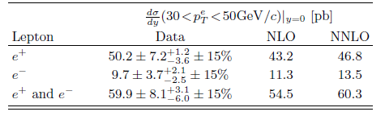

Cross Sections
for W Production in PHENIX
Final Results for RHIC 2009 Run
Phys. Rev. Lett. 106, 062001 (2011)

Slide 31

Longitudinal spin asymmetry A_{L}
Parity violating longitudinal spin asymmetry can be used to access polarized PDF’s by measuring
N⁺(W) = right handed production of W
N⁻(W) = left handed production of W
P = Beam Polarization
Average polarization 0.39±0.04

Slide 32

Parity violating raw asymmetries (ε_{L})
e⁺
e⁻
BG
BG
Signal
42counts
Signal
13 counts
ε_{L}=0 for Background
(as expected)
Large ε_{L} for Signal
(especially in e⁺)
K.Okada (RBRC)

Slide 33


A_{L} for W⁺ / W⁻ samples

Slide 34
Summary
PHENIX & RHIC are doing well, ongoing upgrades are nearly completed, data accumulation in current configuration will continue for 5-7 years. By 2020 PHENIX will go through major upgrade to prepare it for challenges of potential X100 increase in luminosity of RHIC and e-A collisions in eRHIC (~2014);
Recent highlights are:
  Observation of exponential enhancement in the direct photon yield in in pT range below 5 GeV/c interpreted as thermal emission from expanding QGP;
  Measurement of v₂ of thermal direct photons which is large
    It further constrains T_{i} and τ₀
  Measurements of the CNM effects in d+Au
    Non-linear density dependence of shadowing from J/ψ
    Low-x suppression from forward di-hadron correlations
  Measurements of triangular flow v₃
    Disentangle initial state from η/s
  Detailed measurements of the energy loss
    Cubic path-length dependence
  Energy Scan
    v₂ saturation 39 GeV
    R_{AA} suppressed also at 39 GeV
Thank you!

